Slide 1


Analytical Forecasting of Energy Consumption Patterns
IVIE IRIVBOGBE
Forecasting Methods - BANA-7350

Slide 2
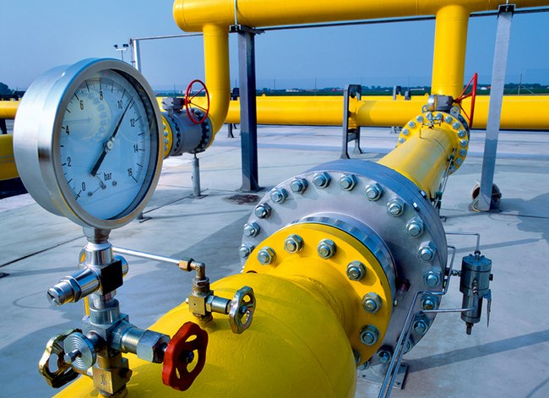
objectives
Develop a forecast model for U.S. natural gas consumption for the next 24 months.
Utilize historical consumption data to predict future trends.
Incorporate economic indicators such as transportation indexes and vehicle miles traveled.
Apply ETS and Holt-Winters to forecast natural gas consumption, capturing trends and seasonality.
Use VAR to analyze consumption with economic indicators for informed resource planning.
Provide actionable insights for stakeholders for informed decision-making for energy production, infrastructure development, and meeting environmental targets.

Slide 3



Data description
Source: Federal Reserve Economic Data
https://fred.stlouisfed.org/series/NATURALGASD11
https://fred.stlouisfed.org/series/CPIETRANS
https://fred.stlouisfed.org/series/TRFVOLUSM227SFWA
Dataset:
Natural Gas Consumption
Research Consumer Price Index: Transportation
Vehicle Miles Traveled
Key Terms:
Natural Gas Consumption: The amount of natural gas used, in billions of cubic feet.
Consumer Price Index-Transportation (CPI Transportation): Tracks changes in transportation costs over time.
Vehicle Miles Traveled (VMT): The sum of all miles driven in a region.

Slide 4
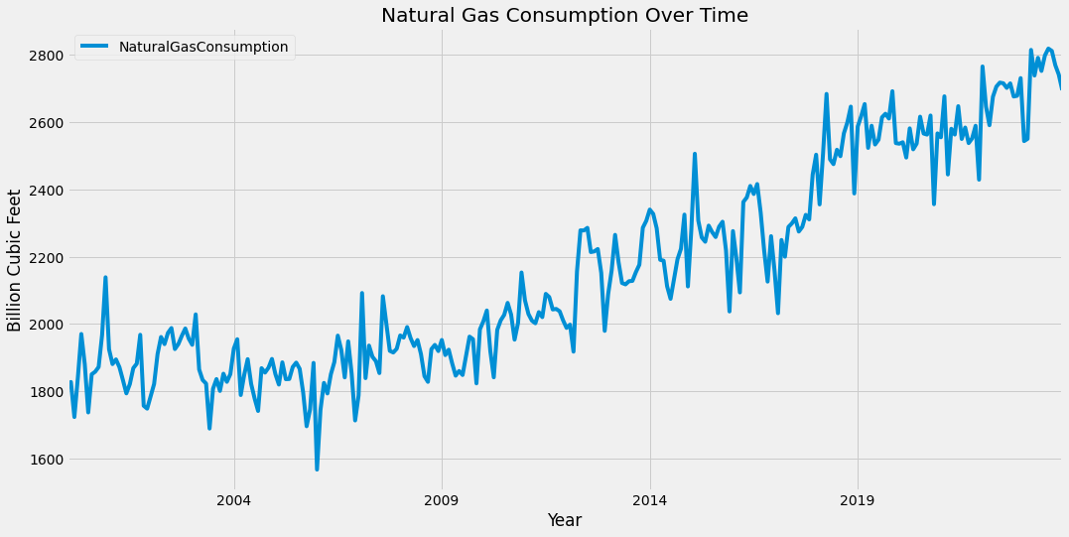
BACKGROUND
Natural gas is a critical energy source. Seasonal demand, economic factors, and energy policies influence its volatile consumption patterns, making accurate forecasting vital for energy planning and market stability.
Rise in natural gas consumption over recent decades due to advancements in extraction methods like fracking.
The shift toward cleaner energy sources has positioned natural gas as a popular choice for electricity generation since the early 2000s.
Increased supply, particularly in the U.S., made natural gas a cost-effective substitute for coal.
Expanding the global natural gas market with the advent of LNG technology facilitates long-distance transport.
Limited but growing interest in using natural gas as a transportation fuel.
Viewed as a transitional fuel in the context of climate change, offering a compromise between reducing emissions and ensuring energy security.
The future role in energy policies is balancing environmental goals and economic/energy security needs.

Slide 5
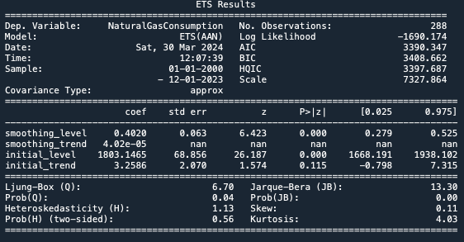
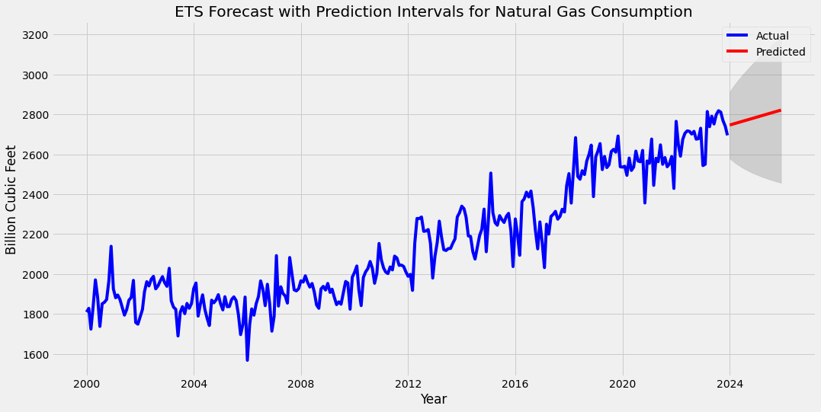
Forecasting Natural gas consumption using ETS(AAN) model
The ETS model predicts future values by analyzing past trends, levels, and seasonal patterns in data.
The statistical tests indicate that there might be unrecognized patterns in the residuals, potentially affecting forecast accuracy.
The model's forecast suggests that natural gas consumption will continue in the current trend, with slight increases over the next 24 months. The shaded area represents the prediction intervals that expand with time, indicating growing uncertainty in long-term forecasts.

Slide 6
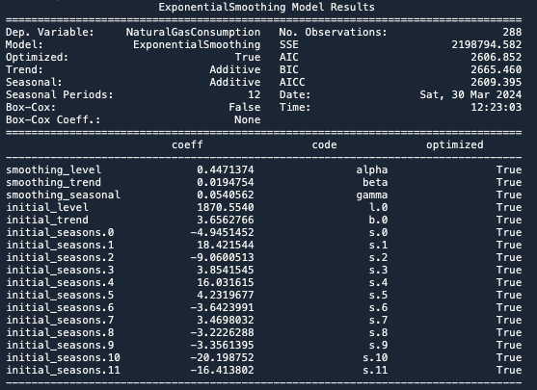
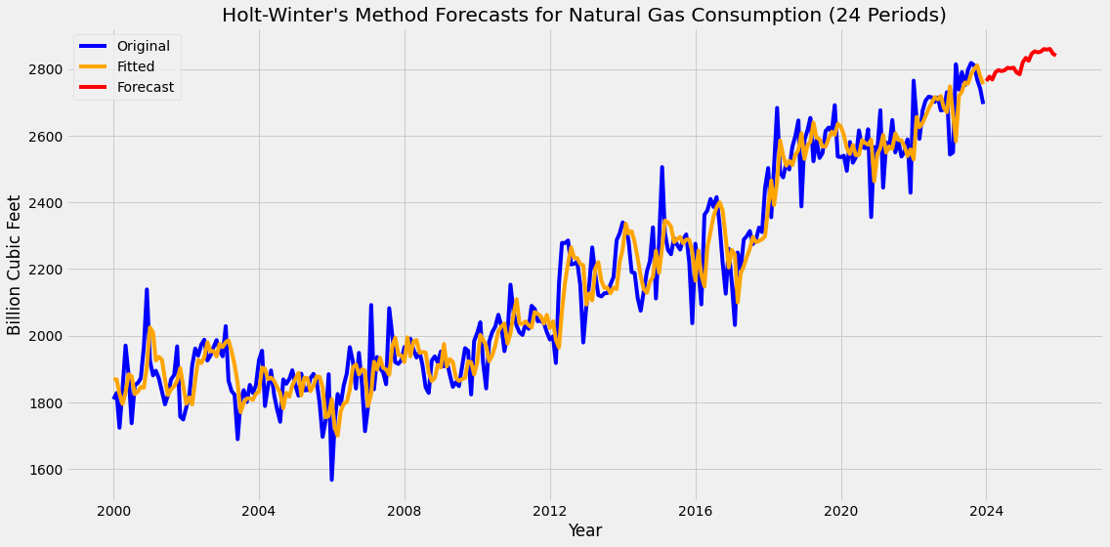
Forecasting Natural gas consumption using The Holt-Winters model
Holt-Winters, an enhanced ETS model, effectively captures seasonality for forecasting data with distinct seasonal trends.
Historical fit accuracy is high, showing a close match between the model's fitted values and actual natural gas consumption.
Projected consumption trends continue, mirroring past cyclical and seasonal patterns.
Forecasts suggest that natural gas consumption will follow historical trends, incorporating past trend directions and seasonal variations.

Slide 7
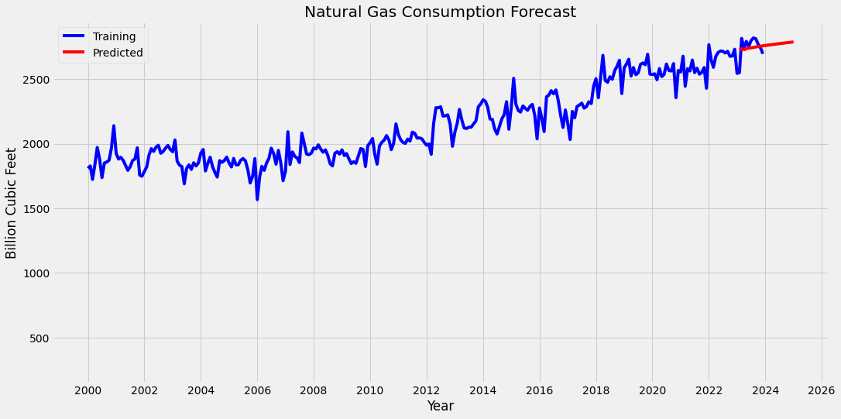
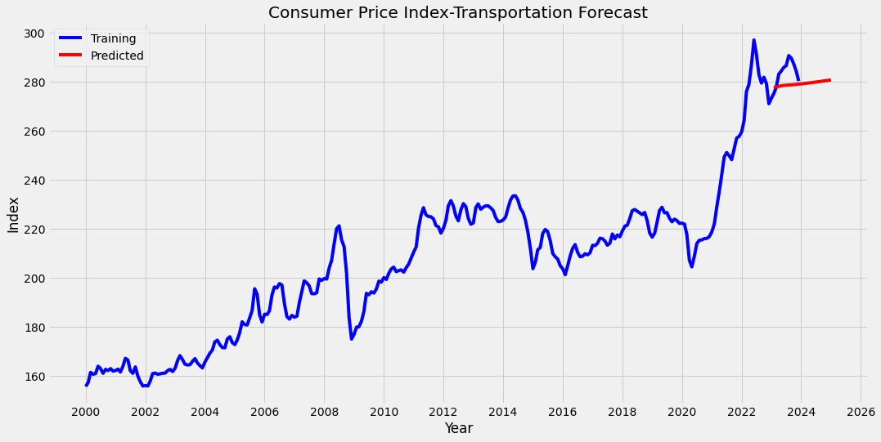
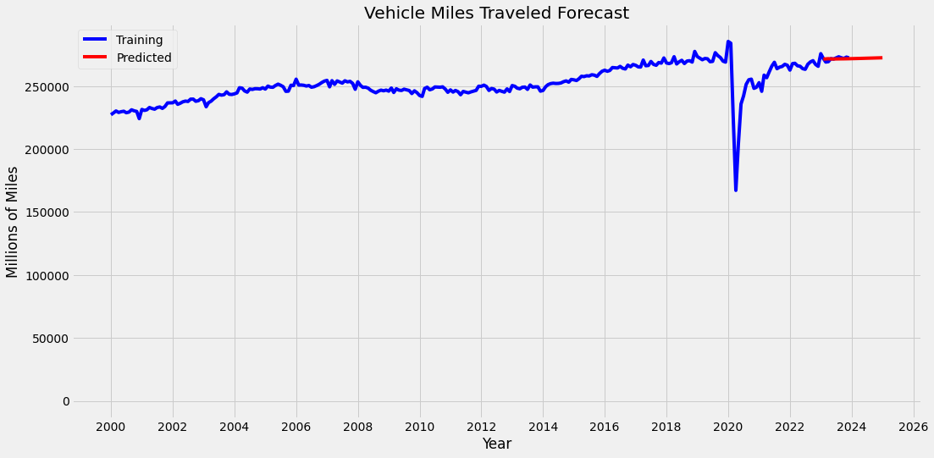
Forecasting using Vector autoregression(var) model
VAR models are ideal for interdependent multivariate time series analysis. They forecast a set of variables using historical data from all variables in the system.
The VAR output shows the dynamic relationship among Natural Gas Consumption, CPI Transportation, and Vehicle Miles Traveled over time.

Slide 8


Correlation Matrix from the VAR
The VAR model demonstrates a strong fit with low error correlations and robust AIC support.
The Independence of Natural Gas Consumption errors suggests accurate model specification.
A mild positive correlation between CPI Transportation and Vehicle Miles hints at minimal co-movement in forecasting errors.
Negligible negative residual correlations point to the variables' near-independence.
Overall, low residual correlations across variables indicate unbiased and reliable forecasts.
Error correlation does not equate to causation but highlights error pattern similarities.

Slide 9
conclusion
Forecast Insights:
Forecasts predict a steady uptick in natural gas use, reinforcing its role as a bridge in the shift to greener energy.
Anticipated growth in demand highlights the urgency for enhanced energy infrastructure and progressive policy development.
Continuous refinement of forecasting models is crucial for adapting to evolving market conditions and policy reforms, prioritizing emission reduction.
Strategic Recommendations:
Sync infrastructure enhancements with the anticipated growth in natural gas usage.
Develop flexible strategies to navigate market fluctuations in energy demand and supply.
Prioritize integration of renewables to progress towards a diversified and sustainable energy portfolio.
Commit to ongoing surveillance of energy consumption patterns, updating predictive models accordingly.
Proactively mitigate methane leakage in the natural gas supply chain to solidify its status as a cleaner energy source.

Slide 10
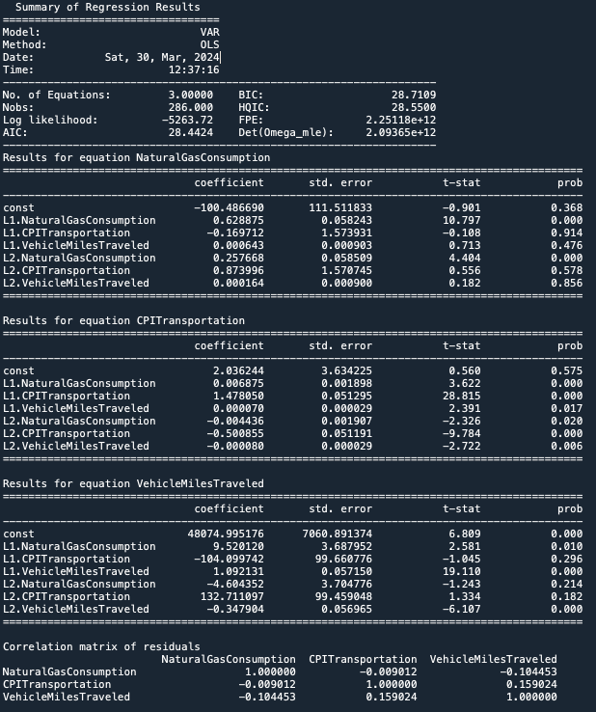
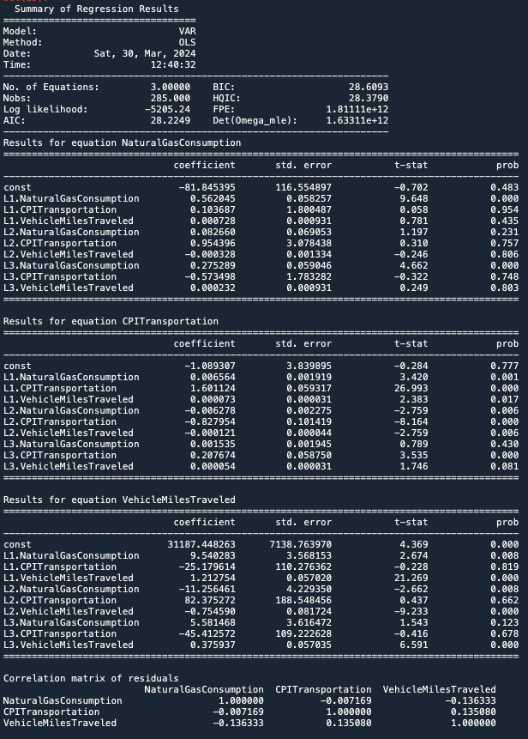
Appendix-VAR Summary

